Slide 1
WELCOME TO OUR VIRTUAL KEEPSAKE ORNAMENT
LOCAL CLUB MEETING

Slide 2




How to participate
Meeting icons:
  Microphones pick up everything. It’s helpful if you keep your microphone muted unless you’re talking. Just click on the microphone icon to mute or unmute.
  Click on the participants icon to see who is attending.
  Click on the chat icon to open the chat feature. Type in questions or answers for the group or host.
Notes:
Start with some “house-keeping” topics, for example – ways to participate in a virtual meeting if your hosting online.

Slide 3
Welcome & Club News
Important Dates & Upcoming Meetings
Organization
Showcase
Artist Corner
Ornament Stories
Ornament Up-Keep
Community Outreach
Notes:
These are some suggested topics, but customize it for your own club!

Slide 4
Club News
Notes:
Share any club updates or business.
Current number of members.
Club dues/budget balance.
Elected positions/upcoming club elections.

Slide 5
Important dates & upcoming meetings
Notes:
Discuss ornament-release event dates, upcoming meetings and/or club activities.

Slide 6
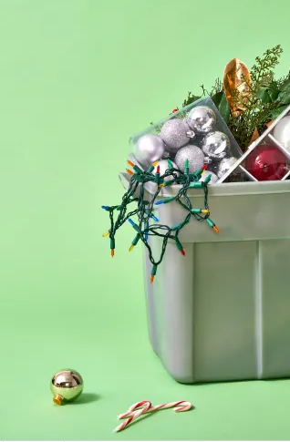
Ornament organization ideas

Slide 7
Cataloging ornaments
Notes:
Share ideas, tools, software, etc. that club members use to catalog their ornaments.
Does anyone use the YuleLog software?

Slide 8
Storing and organizing ornaments
Notes:
Before the meeting ask club members to send pictures of their ornament organization methods to include in the PowerPoint.

Slide 9
Insert images of club members’ ornament organization.
Notes:
Before the meeting ask club members to send pictures of their ornament organization methods to include in the PowerPoint.
When the club member’s picture appears, they can unmute and talk about their strategy or method of organizing their ornaments.

Slide 10
Share your favorite Home displays
Notes:
Before the meeting ask club members to send pictures of their favorite displays to include in the PowerPoint.
Displays, including showing off their year-round or seasonal displays. Items they found to either showcase their ornaments or aid them in making a holiday vignette.
When the club member’s picture appears, they can unmute and talk about the display or items they use for showcasing their ornaments.

Slide 11
Insert images of favorite home displays shared by club members.

Slide 12
Artist corner

Slide 13
Insert images the club member may have of the artist or ornaments.
Notes:
Before the meeting, invite one or two club members to select a favorite artist to talk about, share any convention stories they may have about the artist, and/or talk about one of the artist’s 2021 ornament designs.

Slide 14
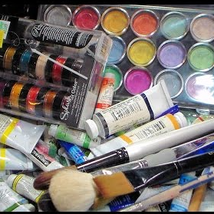
Ornament up-keep
Notes:
Ask club members to share their tips and tricks for repairing ornaments, touching-up paint, etc. What glue is most useful? What tools do they use? What’s the best paint?

Slide 15
Our club, our community
Notes:
Share news about your local club’s activities within the community or plans for community outreach for the year.

